Slide 1
Education and student performance using ai tools
MENTOR: Dr N. Shirisha, Assoc.Prof.
BATCH NO: 15
TEAM MEMBERS:
2320030041 – u.chandrahas
2320090047– d.nagarujuna
2320030226 – s.pardhu

Slide 2
Table of contents
ABSTRACT
INTRODUCTION
EXISTING SYSTEM
PROPOSED SYSTEM
OBJECTIVES
LITERATURE SURVEY
SOFTWARE REQUIREMENTS
HARDWARE REQUIREMENTS
FUNCTIONAL REQUIREMENTS
NON – FUNCTIONAL REQUIREMENTS
SYSTEM ARCHITECTURE
UML DIAGRAM
ACTIVITY DIAGRAM
MODULE DESIGN

Slide 3
Review – 2 comments addressed
1.Modules of the project need to analyse
2.Tools /Requirements gather

Slide 4
ABSTRACT
Education and student performance is a core function of modern academic engineering, providing a set of best practices for maintaining high student success rates in real-world educational environments. Generally, after a considerable period, student engagement and academic performance can degrade when exposed to increasing workload or poor attendance patterns. Traditional management systems cannot always handle the complexity of identifying these subtle decay patterns. Our project focuses on this disadvantage by continuously monitoring and analyzing student metrics through an automated lifecycle pipeline. This is achieved by using a high-performance stack comprising a Flask backend for real-time delivery and Apache Spark for large-scale data processing. We deploy this system to integrate academic performance data into a centralized environment that can take in raw records as an input and return actionable outputs, such as "Burnout Risk" and "Placement Eligibility," used in making practical mentoring decisions. When new data is provided as input, the system automatically updates the stress and risk indices without disturbing the underlying database architecture. This ensures that the identification of at-risk students remains accurate and interventions can be deployed with fewer errors i.e., student outcomes will not be degraded. Our main goal is a robust and efficient monitoring, maintenance, and optimization of student performance and well-being systems in production..

Slide 5
Introduction
Student Education Performance Dashboard – The Student Dashboard is an intelligent analytics platform that aims to monitor, analyze, and manage student academic
Data Analytics Pipeline – It automates the educational data workflow by pulling raw student records Into an analytics engine (like Apache Spark)
The Student Dashboard is used for:
.Real-time Monitoring
.Track Academic performance
.Centralize Student Records
.identifies early signs of academic burnout
.Automating document generation
.Departmental Analysis
.Monitoring overall performance efficiently + automated reporting

Slide 6
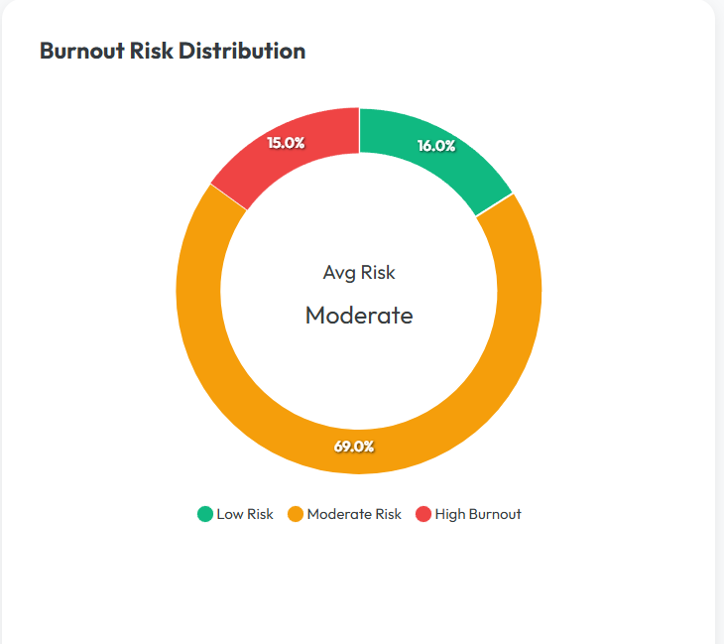
Existing system
Considering the Student Education Performance Environment:
Teachers manually check attendance records (like looking at registers or spreadsheets). They depend on reports from individual teachers about how students are doing. Action is taken only after students fail exams, instead of helping them earlier.
Because of this delayed manual tracking, action is taken only after students fail their exams instead of identifying the warning signs and helping them earlier.

Slide 7
Proposed system
Our goal is to build a robust and efficient platform for deploying, maintaining, and analyzing student educational performance data in real-time.
The main purpose is to continuously track and monitor the academic trajectories of students across all departments.
We are using Apache Spark to automate the complex data aggregation and calculation tasks.
We deploy this automated pipeline alongside an interactive Dashboard using modern web technologies.
The Dashboard helps educators improve intervention times, reduce academic failure rates, and make administrative decisions more productive.

Slide 8
Objectives
The objectives of the proposed system include the following:-
1.To store and process large educational datasets (using Apache Spark)
2. Continuously track and monitor student academic metrics (Attendance, Grades, Backlogs)
3.Provide accurate early-warning Burnout Risk results
4.Performance evaluation should not be delayed until final exam

Slide 9
Software requirements
Below are the software requirements for application development:
1.Python IDE (VSCode / PyCharm)
2.Apache Spark (Data Analytics Engine)
3.SQLite (Transactional Database)
4.InfluxDB (Time-Series Database)
5.Docker (Containerization for Grafana & InfluxDB)
6.Grafana (Visualization Dashboard)
7.GitHub (Source Control)

Slide 10
Hardware requirements
Hardware requirements for application development are as follows:
1.CPU - Intel Core i3 or higher (i5 recommended)
2.RAM – 8 GB or higher
3.Storage – 20 GB or higher
4.OS - Windows 10 or higher

Slide 11
FUNCTIONAL requirements
1.System should process raw student datasets (attendance, grades, backlogs) via Apache Spark.
2.The Risk Engine must process the dataset to calculate the Burnout Stress Index.
3.System should generate automated warning letter PDFs based on calculated risk thresholds.

Slide 12
Non - functional requirements
1.Reliability: The system should securely handle missing values and detect runtime exceptions during large CSV uploads properly.
2.Security: No one should be allowed to modify the content of the database or access student performance profiles without administrator authorization.
3.Scalability: The system should be able to cope up with updates, effortlessly handling thousands of concurrent student records without crashing.
4.Performance: The dashboard response time shall be adequate enough, that's why the time required for the Flask application to query Spark and respond to its user's actions has to be managed and controlled instantly.

Slide 13
Literature survey
S. No | Name of the research paper | Author name | Technologies used | Advantages/ Disadvantages
1 | Evaluation of Italian wine by the electronic tongue: recognition, quantitative analysis and corrolation with human sensory perception,2003 | Legin, Rudnitskaya, Luvova, Vlosov, Natale, D’Amico | Array of sensors, Data processing techniques | Advantage: minimizes human risks involved Disadvantage: Time consuming and results affected by temperature
2 | Selection of important features and predicting wine quality using ML techniques,2017 | Yogesh Gupta | Linear regression, neural networks, SVM | Advantage: more precise predictions Disadvantage: results are not accurate for large datasets
3 | MLOps Overview, Definition and Architecture,2021 | Dominik Kreuzberger, Niklas Kuhl, Sebastian Hirschl | DevOps, ML pipeline | Advantage: automation of ML workflow Disadvantage: still need human assistance

Slide 14
Thank you
S. No | Name of the research paper | Author name | Technologies used | Advantages/ Disadvantages
4 | The machine learning life cycle and the cloud: implications for drug discovery, 2021. | Ola Spjuth, Jens Fridb and Andreas Hellander | MLOps, Deep Neural Networks, Cloud computing. | Advantages: By using MLOps it gives support at all stages in the ML modeling lifecycle. Disadvantages: We need to build trust for collecting sensitive data from different sources.
5 | A Data Quality-Driven View of MLOps, 2021. . | cedric.renggli, luka.rimanic, nezihe.guerel, bojan.karlas, ce.zhang. | CI/CD-Continuous integration and Continuous delivery, DevOps | Advantages: It improves the quality of the model. Disadvantages: Needs continuous monitoring.
6 | Challenges in the deployment and operation of machine learning in practice,2020. | Lucas Baier, Fabian Jöhren Stefan Seebacher | CRISP-DM - standard process model for data analytics, conducted literature reviews and structured interviews with ML practitioners. | Advantage: pre – deployment, deployment, non - technical challenges are addressed clearly providing solutions. Disadvantage: could not cover all industry sectors, only limited statements can be made about the severity of one challenge in comparison to another.

Slide 15
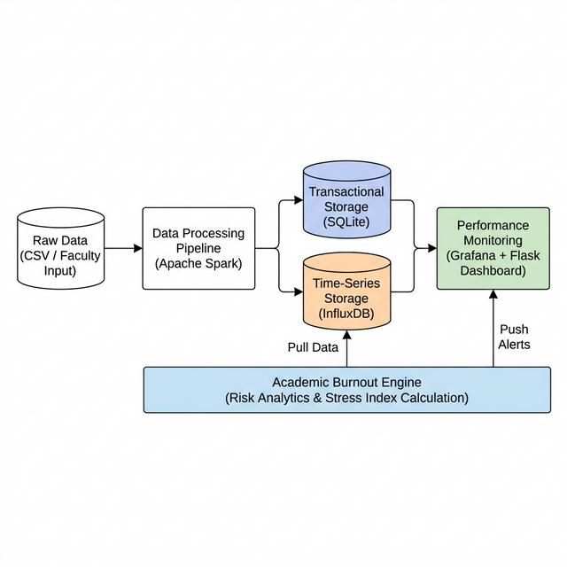
System Architecture
Raw student data is ingested and processed by Apache Spark, then stored across two databases: SQLite for maintaining current profiles and InfluxDB for tracking historical trends. The dedicated Academic Burnout Engine continuously analyzes this dual-storage data to calculate individual Stress Indexes, instantly pushing high-risk alerts and metrics to the live Grafana and Flask Dashboard for administrator action.

Slide 16
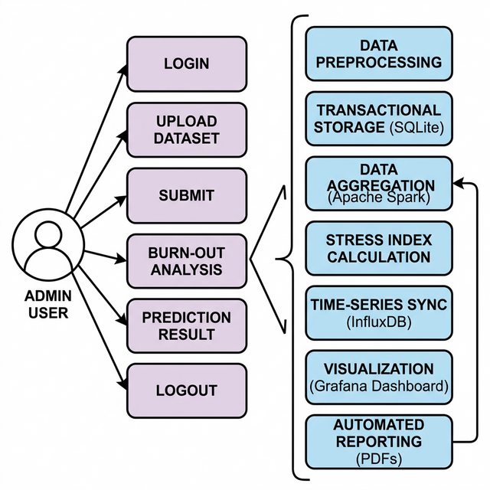
Uml diagram

Slide 17
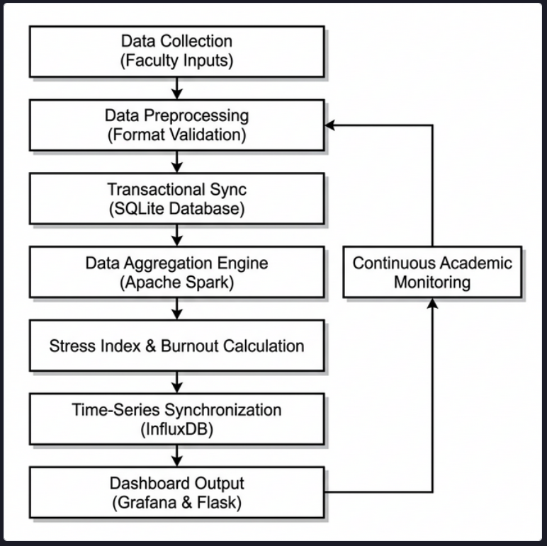
Activity diagram

Slide 18
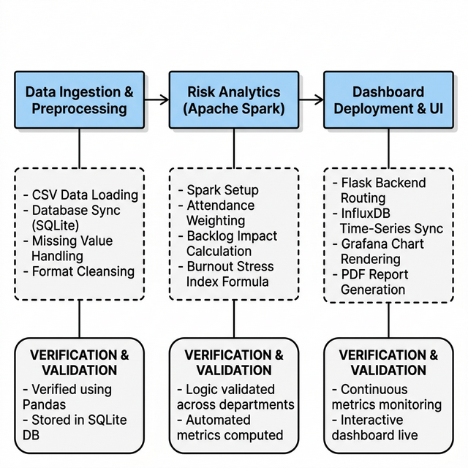
Module design

Slide 19


